Slide 1




A new control parameter for the glass transition of glycerol.
D. L’Hôte, R. Tourbot, F. Ladieu, P. Gadige
Service de Physique de l’Etat Condensé (CNRS, MIPPU/ URA 2464), DSM/IRAMIS/SPEC/SPHYNX CEA Saclay, France
Main Funding:
Additionnal Funding:

Slide 2
The most emblematic claim of this work :
• E_{st} is a new control parameter in Glycerol.
• Previously, the unique way to change Tg was the Pressure Π
Small effect: discovered through a nonlinear technique
• The most interesting is not δT_{g} but what we learn when varying Π, E_{st}.

Slide 3
Outline:
Motivations for nonlinear experiments
II) Our specially designed experiment
III) Results on Glycerol
    Order of magnitude and comparison to the Box model
    Relation to N_{corr}
    Tg shift
IV) Some naives questions/ideas.
Summary and Perspectives.

Slide 4
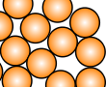
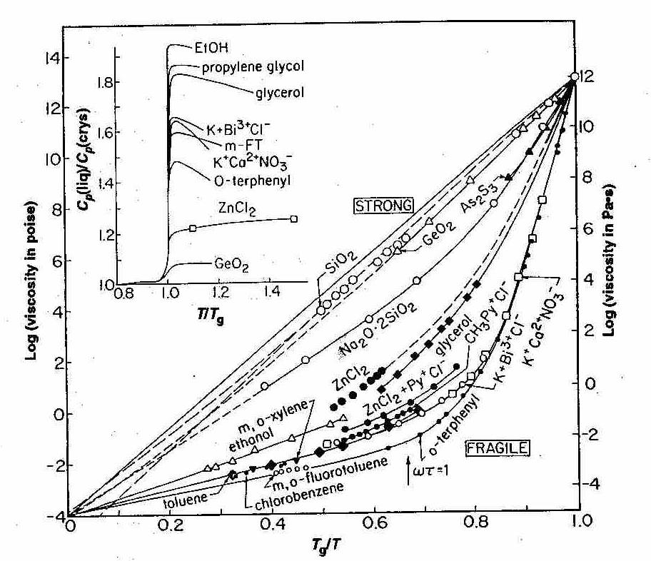
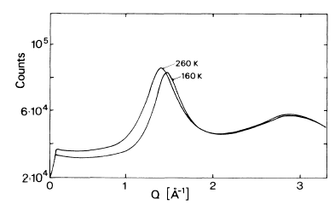
What happens around Tg ???
τ_{α}
Relaxation time τ_{α}
Glass
Supercooled
liquid
Liquid
(Crystal)
τ_{α}=100s
τ_{α}~ 10⁻¹²s
T_{g}
T_{m}
T
Angell, Science 267 (1995)
12
10
8
6
4
2
0
-2
-4
Polybutadiene, T_{g}≈ 180K
S(q) [a.u.]
E_{a}  when T 
Log (viscosity) ∝ τ_{α}
⇒ Correlations  when T 
0 0.2 0.4 0.6 0.8 1.0
No (static) cristalline order
T_{g} / T
T_{g} / T
How to combine the existence of correlations with the absence of order ?

Slide 5
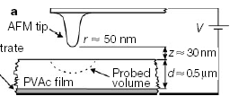
Dynamical Heterogeneities in supercooled liquids
N_{corr} = average number of dynamically correlated molecules :
… directly observed in granular matter or in numerical simulations.
Example : numerical simulations on soft spheres :
…Experimentally, the heterogeneous nature of the dynamics has been established through various breakthroughs:
NMR experiments
Local measurements
Tracht et al. PRL81, 2727 (98),
J. Magn. Res. 140 460 (99),…
E. Vidal Russell and N.E. Israeloff , Nature 408, 695 (2000).
Hurley, Harowell, PRE, 52, 1694, (1995)
« clusters » of 30-90 monomers
• Hole burning experiments
When T↓: N_{corr} would ↑, which would explain why τ_{α} increases so much

Slide 6
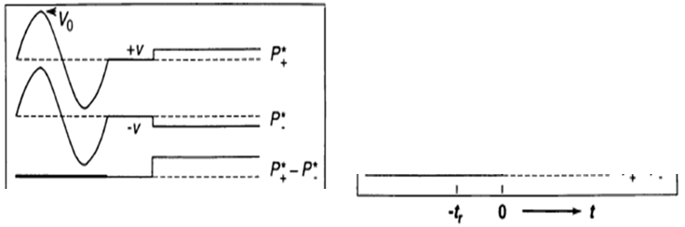
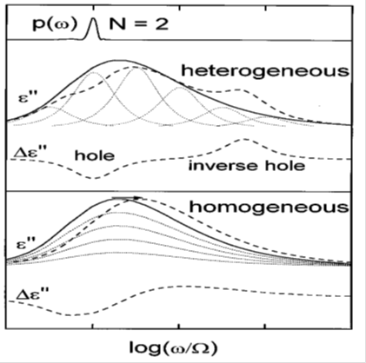
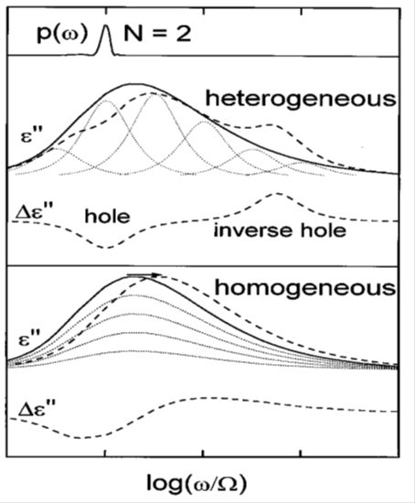
Dynamical Heterogeneities and NHB.
• Many improvements since Schiener, Böhmer, Loidl, Chamberlin Science, 274, 752, (1996)
e.g. R.Richert’s group: PRL, 97, 095703 (2006); PRB 75, 064302 (2007); EPJB, 66, 217, (2008); PRL, 104, 085702, (2010)…
• The central idea in Schiener et al ’s seminal paper in 1996:
No distribution of τ
ε(t,ω) : should be globally shifted in ω
Strong field (V₀) at Ω
A distribution of τ’s exists
ε(t,ω) : should be mainly modified close to Ω
Non Res Hole Burning: ⇒supercooled dynamics IS heterogeneous (at least in time)
•… Can nonlinear experiments give MORE than originally expected ??....

Slide 7
The prediction of Bouchaud-Biroli (⬄B&B): PRB 72, 064204 (2005)
AND
N_{corr} « large enough »
H
Natural scale of χ₃
χ_{s}= static value of χ_{Lin}
a³= molecular volume
N_{corr}= number of dynamic. correlated molec.
τ_{α} (T) : typical relaxation time
H: scaling function
« 1 »
ωτ_{α}
Systematic χ₃(ω,T) measurements to test the prediction and possibly get N_{corr}(T)

Slide 8
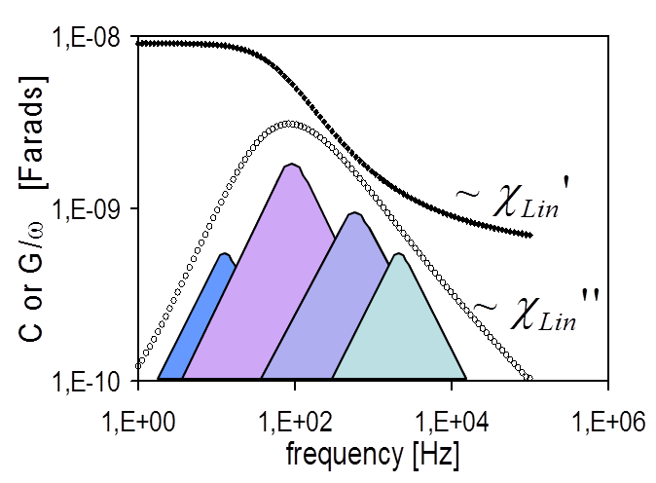
The issue of interpretations : Box Model versus B&B
Box model assumptions (designed for NHB):
→ Each DH « k » has a Debye dynamics.
{τ_{k}} chosen to recover χ_{lin}(ω) at each given T.
→ Applying E: each DH « k » is heated by δT_{k} (τ_{therm}) with τ_{therm} ∼ τ_{k}.
⌠as{τ_{k}}∼τ_{α} heat diffusion over one DH takes a macroscopic time close to Tg.
χ₃
For a pure ac field E_{ac} cos(ωt): ω and T dependences are qualitatively similar in the Box model and in B&B
χ₃ does NOT contain N_{corr} (Box model is space free)
« 1 »
ωτ_{α}
χ₃(ω,T) : N_{corr}(T) or not ?

Slide 9
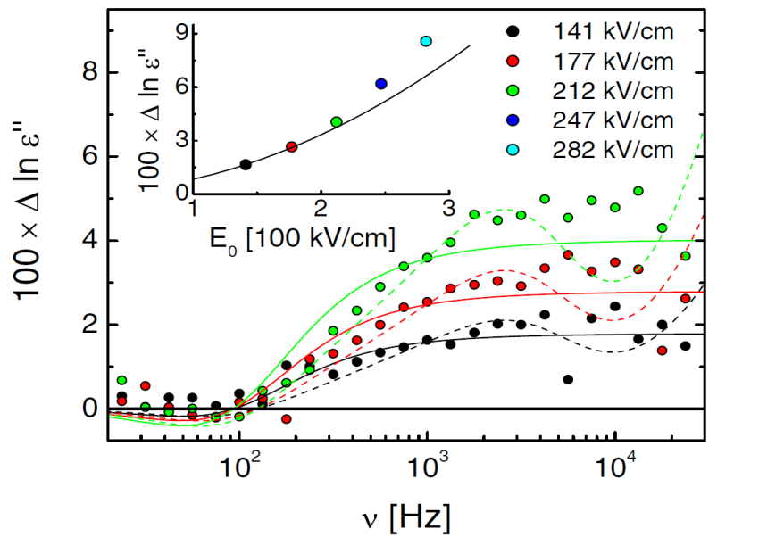
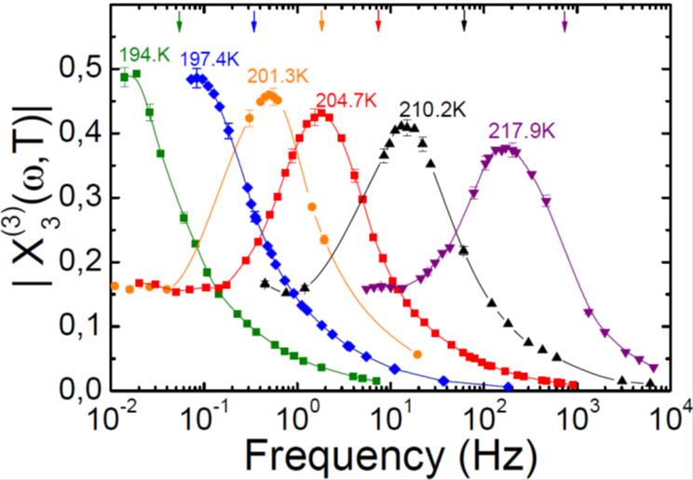
Some experiments done since B&B’s prediction (2005)
Box model :
B&B:
e.g. R.Richert’s group: PRL, 97, 095703 (2006); PRB 75, 064302 (2007); EPJB, 66, 217, (2008); PRL, 104, 085702, (2010)…
Our group: PhD’s of C. Thibierge and C. Brun. PRL (2010); (2012) PRB (2011) (2012); JChem Phys (2011) ,
Augsburg group: PhD of Th. Bauer : 2 PRL’s in (2013); etc…
→ Very good fits at 1ω (better than at 3ω)
→ Test of B&B’s prediction: OK
→ Accounts for the transient regime at 1ω
→ Evolution of N_{corr}(T) or of N_{corr}(t_{a})
→ Several liquids tested (Richert PRL (2007))
→ Several liquids tested (Lunkenheimer & Loidl)
Using E_{st} will shed a new light on this interpretation issue

Slide 10
Outline:
Motivations for nonlinear experiments
II) Our specially designed experiment
III) Results on Glycerol
    Order of magnitude and comparison to the Box model
    Relation to N_{corr}
    Tg shift
IV) Some naives questions/ideas.
Summary and Perspectives.

Slide 11
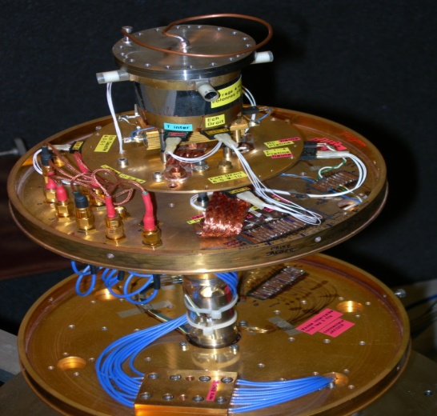
Dielectric setup and orders of magnitude
V_{S} (t)
Supercooled liquid, controlled T
P
e
For “low enough” E
Linear term
First non-linear term
⇒ Specially designed setup

Slide 12
Our setup to measure cubic susceptibilities
Bridge with two glycerol-filled capacitors of different thicknesses
C. Thibierge et al, RSI 79, 103905 (2008))
V_{ac} e ^{j ω t} + V_{st}
Z₂ = thick
capacitor
(2×thin)
Z₁ = thin
capacitor
ΔV = V_{meas}(V_{ac},V_{st})
V_{meas}
- V_{meas}(V_{ac},0)
I_{Lin} +
I_{NonlLin}
2 I_{Lin} +
8 I_{NonlLin}
r₁
r₂
• when r₁Z₁=r₂Z₂ : P_{lin} cancels
gives P_{NonLin}
ΔV~ V_{st}² V_{ac}
Phase (ΔV) = cte

Slide 13
Outline:
Motivations for nonlinear experiments
Our specially designed experiment
III) Results on Glycerol
    Order of magnitude and comparison to the Box model
    Relation to N_{corr}
    Tg shift
IV) Some naives questions/ideas.
Summary and Perspectives.
• NB:
ωτ_{α} ≡ f/f_{α}
f_{α} ⬄peak of χ_{lin}’’(ω)
|χ_{lin}(ω)| has no peak

Slide 14
Main features of
At constant T:
• humped shape for |χ_{2;1}⁽¹⁾|
• maximum happens in the range of f_{α}
Scaling of the hump in T
Same qualitative trends as for χ₃⁽¹⁾ and χ₃⁽³⁾

Slide 15
Comparing and
⇒ Compare |χ₃⁽¹⁾|/4 and |χ_{2;1}⁽¹⁾|
→ Same order of magitude
, [m²/V²]
→ Measurements ( • ) are in the stationnary regime (τ_{st}>> τ_{α})
Ε_{st}
τ_{st}
t
Varying E_{st} ⬄ ZERO dissipated power
Box model’s prediction :|χ_{2;1}⁽¹⁾|<< |χ₃⁽¹⁾|
(ions)
Box model’s prediction is too small by a factor 300 for |χ_{2;1}⁽¹⁾|
For the first time, Box Model is unable to account for a cubic response:
Decisive point for the interpretation issue …

Slide 16
Outline:
Motivations for nonlinear experiments
Our specially designed experiment
III) Results on Glycerol
    Order of magnitude and comparison to the Box model
    Relation to N_{corr}
    Tg shift
IV) Some naives questions/ideas.
Summary and Perspectives.

Slide 17
Comparing the ω dependences of and of
• For f/f_{α} > 0.2:
197K
218K
with
∀ T
for both Re and Im parts
Direct link with
expected from
Berthier et al., Science (2005); JCP, (2007); PRE (2007).
• For f/f_{α} < 0.2: “Trivial” dominates
Reshuffling ⇒ Ideal gas at t >>τ_{α}
⇒

Slide 18
T-dependences of the dimensionless nonlinear suscept.
is T-independent in the trivial limit (ideal gas)
if B&B’s prediction holds
• “Trivial”
looks OK
• Similar T dependences for
ω and T dependences consistent with X_{2;1}⁽¹⁾ ~ N_{corr} (OK within MCT)

Slide 19
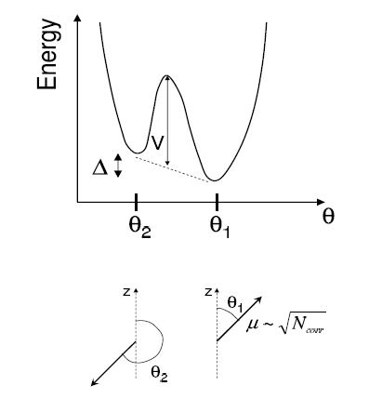
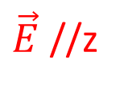
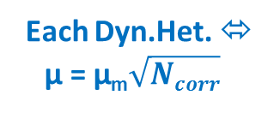
Can we fit nonlinear resp. ? The ‘‘toy model’’ as an attempt :
Each Dyn.Het. ⬄ µ = µ_{m}$\sqrt{Ncorr}$
Simplest example: Δ=0=θ₁
in a double well (to get long τ),
of assymetry Δ
$\vec{E}$ //z
Two key points
⬄ Amorphous Order («as» in S.G.)
can it fit the data ? …
Crossover to trivial is enforced at f<<fα

Slide 20
Fits at Tg+17K:
L’Hôte, Tourbot, Ladieu, Gadige to appear in PRB (2014)
N_{corr}=10
δ=0.60
• N_{corr} has the right order of magnitude
• good fits for ALL the X_{n}^{(k)}
• … but with different values of N_{corr} (toy model)
N_{corr}=15
δ=0.60
Ladieu, Brun, L’Hôte, PRB 85, 184207, (2012)

Slide 21
Outline:
Motivations for nonlinear experiments
Our specially designed experiment
III) Results on Glycerol
    Order of magnitude and comparison to the Box model
    Relation to Ncorr
    Tg shift
IV) Some naives questions/ideas.
Summary and Perspectives.

Slide 22
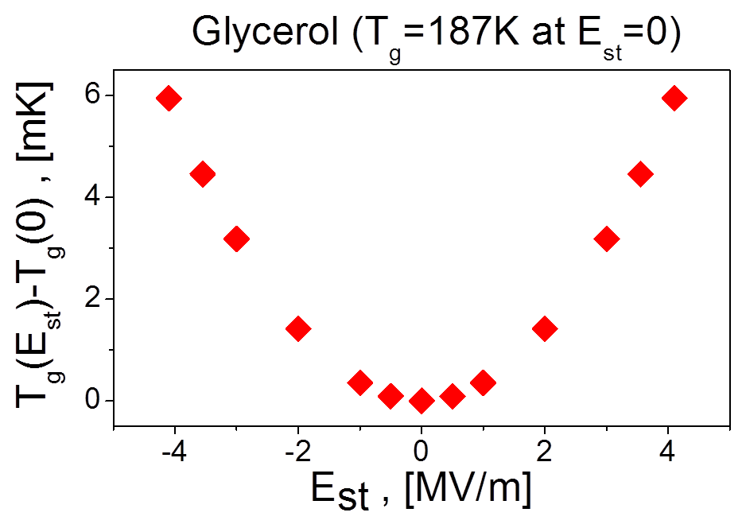
Translating χ_{2,1}⁽¹⁾ as a δTg shift
Hensel-Bielowka et al. , PRE (2004)
Pressure experiments:
δT_{g}(Π) is drawn from :
Same method for E_{st}:
Slight trivial distortion of χ_{2,1}⁽¹⁾ ⇒λ≠1
δT_{g}=3κE_{st}² ⬄ E_{st} is a new control parameter in glycerol

Slide 23
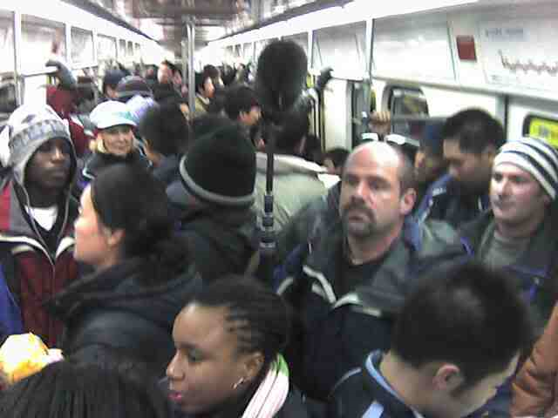

A picture: D.H. ≈ overcrowded subway
N_{corr}
Increasing Pressure …
Increasing E_{st} …
Density ↑… ⇒Σ ↓ and τ_{α}↑
E_{st} ↑… ⇒Σ ↓ and τ_{α}↑

Slide 24
Outline:
Motivations for nonlinear experiments
Our specially designed experiment
III) Results on Glycerol
    Order of magnitude and comparison to the Box model
    Relation to Ncorr
    Tg shift
IV) Some naives questions/ideas.
Summary and Perspectives.

Slide 25
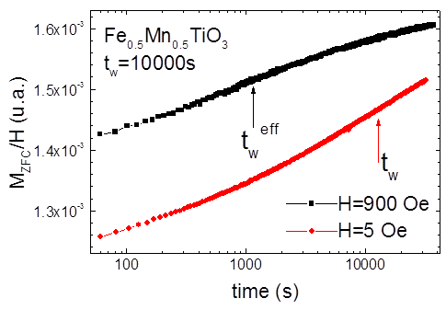
Does T_{K} follow T_{g} ?
• We find δT_{g} (E_{st}) > 0
• S.G: δT_{g} (H_{st}) < 0 or “very negative”
|Ε_{st} |
|Η_{st} |
« true » glass
« Supercooled liquid »
Spin Glass
Paramagnet
T_{K}
T_{g}
T
T_{c}
T
Is it allowed that δT_{K}(E_{st})>0 ? → e.g. peculiarity of 1RSB ?
• E_{st} slows down the dynamics
• S.G.: H_{st} speeds up the relaxation
Y.G. Joh et al, PRL 82, 438 (1999)
and Saclay data
Not a contradiction since T>T_{g} differs from T<T_{c}

Slide 26
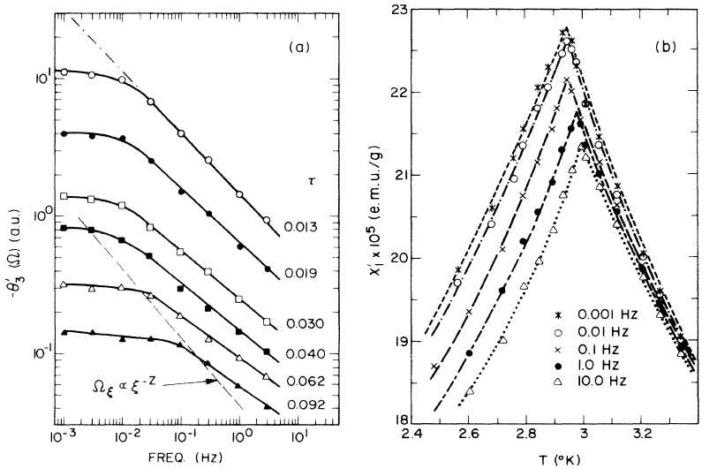
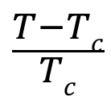
Can we test theories with cubic responses?
Brun et al. PRB 84, 104204 (2011)
L. Levy et T. Oglieksi PRL57, 3288 (1986), L. Lévy, PRB, 38, 4963 (1988)
N_{corr} [a.u.]
Above Tg
Too narrow to test theories relating τ_{α} and N_{corr}
$$\frac{T−Tc}{Tc}$$
χ₃ (a.u.)
τ_{α}, [s]
Quench at Tg-7K
N_{corr} /N_{corr}(eq)
In Spin Glasses: critical behavior nicely evidenced
Brun et al. PRL109, 175702 (2012)
t_{a}, [s]
Quasi equilibrium

Slide 27
Can we test theories with cubic responses?
Brun et al. PRB 84, 104204 (2011)
Brun et al. PRL109, 175702 (2012)
N_{corr} [a.u.]
Above Tg
N_{corr} [a.u.]
Below Tg
AND
τ_{α}, [s]
τ_{α}, [s]
Consistent with RFOT
Consistent with Cammarota et al, JCP (2009)
NB: yields z>20 : not reasonnable
We can test theories

Slide 28
Recent works on cubic responses
→ In colloids: experiments and MCT done for oscillatory shear :
• See Brader et al, PRE, 82, 061401, (2010)
• MCT for oscillatory stress is coming: see Matthias Fuchs papers (Konstanz univ.)
→ In supercooled liquids:
• Bouchaud Biroli PRB 72, 064204 (2005) and Tarzia et al, JCP (2010) in MCT
G. Diezemann : PRE, (2012); JCP(2013); arXiv: 1407.4333v1
  no general link between χ₃ and four times correlation functions (trap models…)
  This link depends on the chosen model and chosen observable.
How to choose a good model ?
AND crossover to trivial
A model accounting for χ₃ will ALSO capture dyn. spatial aspects ☺
Why not simulate ? (d=3)
with
1
t / τ_{α}

