Slide 1
Critical Phenomena in Random and Complex Systems Capri September 9-12, 2014
Spin Glass Dynamics at the Mesoscale Samaresh Guchhait* and Raymond L. Orbach**
*Microelectronics Research Center
**Texas Materials Institute The University of Texas at Austin
Austin, Texas 78712 orbach@austin.utexas.edu
Phys. Rev. Lett. 112, 126401 (2014)
Phys. Rev. B, submitted for publication (2014)

Slide 2
Spin Glass Behavior at the Mesoscale
Growth of spin glass correlation length after nucleation:
At time t = t_{co}, spin glass correlation length ξ(t_{co}, T ) = L
Then for t > t_{co}, spin glass dynamics will cross over from d = 3 to d = 2 state
But if the spin glass lower critical dimension
d_{l} > 2, then spin glass temperature T_{g} → 0
However, there are states with length scales less than the sample thickness L
(c₁, c₂ are constants)

Slide 3
Relaxation dynamics at the Mesoscale
When ξ(t,T ) = L, there is a largest Hamming distance, and hence a highest barrier height Δ_{max}(t_{co}, T):
Moreover, because of ultrametric geometry, there is an exponentially large number of states associated with highest barrier
Hence, after cross over, spin glass dynamics will change from conventional to exponential

Slide 4
Amorphous Ge:Mn Sample Preparation
TEM
STEM
15.5
nm
15.5
nm
Amorphous Ge:Mn prepared by ion implantation
Average Mn concentration ≈ 11 at. %, T_{g} ≈ 24 K.
Mn concentration is uniform within few percent
Guchhait et al., Phys. Rev. B 84, 024432 (2011).

Slide 5
Determination of Spin Glass Dynamics Time Constant, Highest Barrier Height: Δ_{max}(t_{co}, T)

Slide 6
Determination of Ge:Mn Spin Glass Cross-Over Time: t_{co}

Slide 7
Determination of constants c₁ and c₂
We have two equations:
J. Kisker et al., Phys. Rev. B 53, 6418 (1996):
0.12 < c₂ < 0.13

Slide 8
Spin glasses are at criticality at all temperatures T < T_{g} , associated with diverging barrier heights at all temperatures T < T_{g}
Initial conditions set subsequent dynamical properties
When a thin film is quenched to a “quench temperature”, Δ_{max}(T) is set by the minimum length scale of the system (here the thickness of the film) independent of T (Eq. 1):

Slide 9
Temperature Dependence of Δ_{max}(T)
J. Hammann et al., Physica 185A, 278 (1992) have shown that a particular barrier Δ has a temperature dependence that can be followed experimentally.
In the case of thin films, the largest barrier is set by the thickness of the film when t > t_{co} at the quench temperature.
Once Δ_{max} has been set, its temperature dependence, Δ_{max}(T), can be followed as a function of temperature T because of ultrametricity.

Slide 10
Unusual Behavior of ξ(t, T) for Very Thin Films
At 15.5 nm, ξ(t_{co}, T) equals the sample thickness at very long times for T significantly below T_{g} [e.g. t_{co} = 5 x 10⁵ sec for T/T_{g} = 0.83], and becomes of the order of the age of the universe for T/T_{g} ~ 0.5.
But at 3 nm, the opposite is true.
As an example, consider a Cu:Mn 13.5 at.% sample for which T_{g} = 66.8 K, a₀ = 4.45 Å, and scaling from previous fittings [Joh et al., Phys. Rev. Lett. 82, 438 (1999)], c₁ = 0.653 and c₂ = 0.169, and 1/τ₀ = 9.2 x 10¹² sec⁻¹.
At ξ(t_{co}, T) = 3 nm = 30 Å and T = 37.5 K (T/T_{g} = 0.56), inserting into
generates t_{co} = 5 msec.
This means that the crossover from d = 3 to d = 2 can take place over a very large range of temperatures for very thin films.
Consider the work of Sandlung et al. [30 Å films] and Granberg et al. [20 Å films] of Cu:Mn 13.5 at.%:

Slide 11
Dynamic Susceptibility χ(τ) as a function of temperature T for Cu:Mn (13.5 at.%): (1/τ = ω) [Sandlung, et al. Phys. Rev. [Granberg et al., J. Appl. B 40, 869 (1989)] Phys. 67, 5252 (1990)]

Slide 12
Fitting to the temperature at which χ(τ) peaks, From Sandlung et al. and Granberg et al.

Slide 13
Extraction of Δ_{max}(T)
Ultrametricity leads to an exponential increase in the occupation of states with increasing Hamming distance, proportional to increasing Δ.
The dynamics are then controlled by the occupied states at the largest Hamming distance, or, concomitantly, with the largest Δ, Δ_{max}(T).
The dynamics are given by a simple activation relationship at any temperature T above or below the quench temperature:
1/τ = (1/τ₀) exp[-Δ_{max}(T)/k_{B}T]
Reading off τ and the peak temperature T (where the response is a maximum) yields Δ_{max}(T).

Slide 14
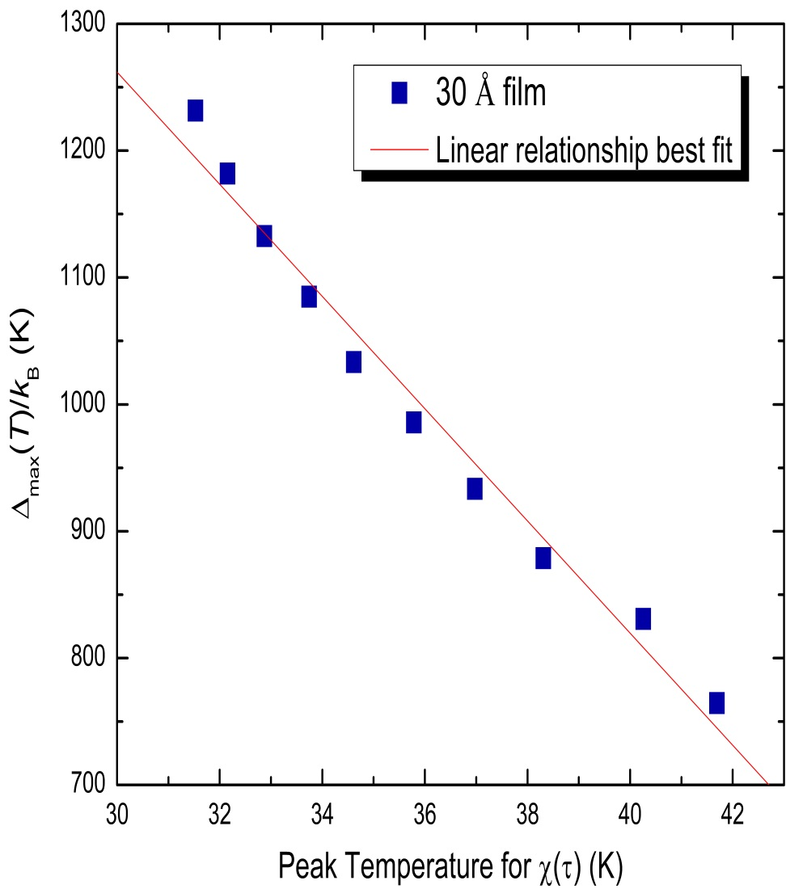
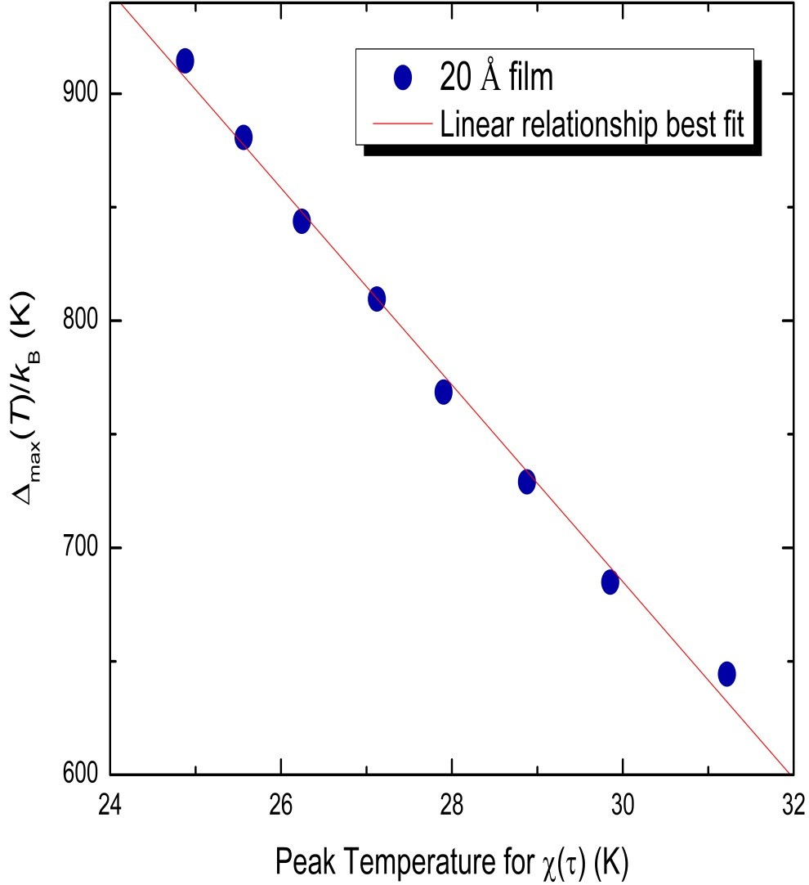
Extracted values of Δ_{max}(T)

Slide 15
Self Similarity of Dynamical States
It is seen in other experiments [J. Hammann et al., Physica 185A, 278 (1992)] that the fit to
is independent of T. That is, the same distribution of meta-stable states is true for all initial conditions (quench temperatures). This is evidence of self similarity for the meta-stable states. Unfortunately, there appears to have been only a single quench temperature in the experiments of Sandlung et al. and Granberg et al., so the self-similarity of states cannot be probed. Nevertheless, the evidence from previous measurements suggests that T* is general: “you give me a value of Δ_{max}(T), and I’ll tell you at what T* it will diverge.”

Slide 16
From then on, the value of Δ_{max}(t_{co}, T) at a temperature T is in reference to the initial value of Δ_{max} at the quench temperature

Slide 17
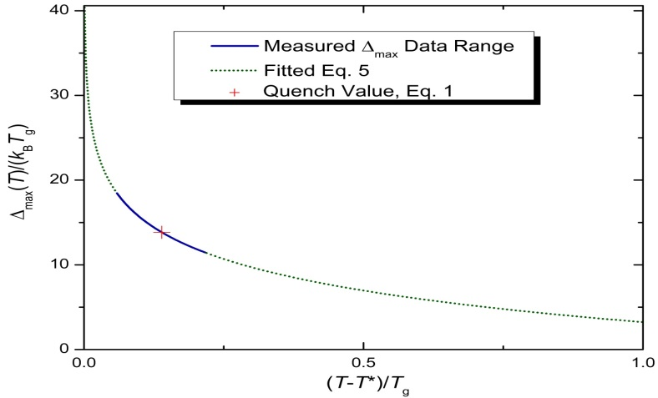
“Divergence” of Δ_{max}(T) for the 30 Å film
where (Eq. 4):
Integration leads to (Eq. 5):
where T* is an integration constant, and the temperature at which Δ_{max}(T) diverges:

Slide 18
Comparison of 20 Å and 30 Å films
Fluctuations in δΔ_{max}(T)/δT for 20 Å film are too severe to fit
With an average distance between spins of ≈ 4.45 Å, there are only of the order of 40-50 spins within a correlation length volume.
The 30 Å film contains ≈ five times as many spins, and appears to be a precursor to bulk behavior.
It would be of interest to examine film thickness in between to see where bulk behavior sets in.

Slide 19
Cooling rate dependence of χ_{FC}
Sandlund et al. observe “a pronounced cooling rate dependence of the FC susceptibility, with the knee shifting towards lower temperatures with decreasing cooling rate.”
Associating the decrease in cooling rate with an increase in τ is consistent with the growth of Δ_{max}(T) as the temperature is lowered.
Divergence of Δ_{max}(T) represents an infinite time scale for τ.
This leads to a projected “knee” in the FC susceptibility M_{FC}/H at T = T* ≈ 28.2 K in the τ → ∞ limit.

Slide 20
Dynamic Susceptibility χ(τ) as a function of temperature T for Cu:Mn (13.5 at.%): (1/τ = ω) [Sandlung, et al. Phys. Rev. [Granberg et al., J. Appl. B 40, 869 (1989)] Phys. 67, 5252 (1990)]

Slide 21
“Critical” behavior (?)
Inserting activated dynamics for τ into Eq. 5 leads to
the conventional form for critical dynamics.
The fit to the 30 Å film yields β = 0.19 and T* = 28.2 K. With a quench temperature of T ≈ 37.5 K, the critical exponent zν = 1/[β(T/T_{g})] ≈ 9, in remarkable agreement with bulk spin glasses.
T* = 28.2 K is close to the critical slowing down analysis of Granberg et al. of T_{g} = 26 K.

Slide 22
Differences in Interpretation
The interpretations presented here are in marked contrast to Sandlung et al. and Granberg et al. whose data we have analyzed.
They associate their time scales with a generalized Arrhenius law using droplet scaling theory for two-dimensional spin glass systems.
They extract a “freezing temperature” associated with the maximum in the time-dependent susceptibility:
with ψν = 1.6 ± 0.2 and T_{f} = 26 K.
We keep T_{g} fixed at 66.8 K, and associate the apparent freezing temperature with the temperature for the divergence of Δ_{max}(T).

Slide 23
Summary
The mesoscale takes advantage of dimensionality to explore spin glass dynamics at dimensions d < 3
Growth of the correlation function ξ(t, T) allows transition from dimensionality d = 3 to d = 2 at a time t = t_{co}
Because the lower critical dimension d_{ℓ} > 2, only states with ξ(t_{co}, T) ≤ sample dimensions remain
Relaxation dynamics are controlled by largest remaining length scale [ξ(t_{co}, T) = sample dimensions], and hence the largest remaining barrier Δ(t_{co}, T) ≡ Δ_{max}(T), leading to activated dynamics
Activated dynamics, and t_{co}, are observed for a-Ge:Mn thin films

Slide 24
Summary (Continued)
For very thin films, ξ(t, T) can grow rapidly to sample dimensions, even for temperatures far below T_{g}.
States remaining, for ξ(t, T) less than sample dimensions, continue to exhibit bulk properties as long as there are sufficient number of spins
The temperature dependence of Δ_{max}(T) can be extracted from measurements of the dynamic susceptibility χ(τ) for 30 Å Cu:Mn thin films
The divergence of Δ_{max}(T) at T = T* leads to a natural explanation of thin film Cu:Mn critical dynamics , with an exponent zν equal to bulk values
The mesoscale offers opportunities to study critical dynamics over a broad temperature range.

